Slide 1
Studying selfhood as a rhizomatic story
Thursday 31st March 2011 University for Humanistics Utrecht, The Netherlands

Slide 2
Two concepts
Rhizome Jasmina Sermijn (2008) IDNS-PE, VUB Brussels
Lines of flight Maria Tamboukou (2008-10) CNR, UEL London
Gilles Deleuze Felix Guattari

Slide 3
Two concepts
Rhizome Jasmina Sermijn (2008) IDNS-PE, VUB Brussels
Lines of flight Maria Tamboukou (2008-10) CNR, UEL London
Gilles Deleuze Felix Guattari

Slide 4
Psychiatric diagnoses and the construction of the self
Jasmina Sermijn (2008)

Slide 5
Research question
THE NARRATIVE CONSTRUCTION OF SELFHOOD
( the local/singular level)
PSYCHIATRIC DIAGNOSIS
(the collective/broader context: DSM-IV psychiatric discourse)

Slide 6
Subject/self: A social-constructionist, narrative perspective
Something continuously constructed and reconstructed in and through the stories someone tells about her/himself
The narrative self as
A product of language and discourse
A producer of language and discourse

Slide 7
A psychiatric diagnosis: A social-constructionist perspective
A professional construct, an interpretation of the subjective experiences of persons used to give a socially and powerful accepted meaning to specific phenomenons
Always embedded in a specific culture and time (e.g.‘homosexuality’ in the DSM)

Slide 8
Methodology
How to explore the interaction between the narrative construction of the self and a psychiatric diagnosis?
Listen to and study the stories that persons constructs about themselves after getting a psychiatric diagnosis

Slide 9
(Researcher) As I already mentioned by e-mail and phone, I’m interested in the way people who have received a diagnosis tell about themselves. So the idea is that you tell me more about yourself and your life today. I don’t have any prepared questions, so it’s really the idea that you tell about what’s important to you.
(Charlotte) ok (laughs) ok, so where should I start…
(Researcher) you really can start where you want to, tell about what’s important to you
(Charlotte) yeah, … let’s see, yeah, that’s hard (laughs). Yeah, I just say, that’s tricky, it’s so hard to start from nothing…, maybe I’ll just tell what I’m thinking right now… So last year, or was it two years ago in the summer, I wasn’t happy with myself. I didn’t feel fat, but I didn’t feel good about myself and I started to eat less and less, I didn’t think I was pretty, but I still ate. But I ate less and less … and it got worse and worse …I think about something now : actually I was already interested in anorexia earlier. I remember that I used to read books, novels about girls who thought they were fat, and once I gave a presentation about it. Maybe that’s the reason, what made me actually get it. I don’t know… The psychologist says it’s other stuff, that it has to do with my relationship with my parents … but I don’t believe that. I think that maybe it comes from those books… What would my parents have to do with it? … yeah, and when I went to the hospital I had to go to the psychologist every week for an hour and I really liked that. In the beginning it was so hard there … then my eating schedule was adjusted. I had to eat more, that was really hard, all these things I never wanted to eat. Now I don’t have anymore problems with it. Now I’m completely better…. I don’t know if I’m really completely better but I feel completely better, but I don’t know if I’m completely better. I feel completely better. This period’s kind of in the past. Yeah, it’s still … if I see other girls eating an apple for lunch … there are still some of those things in my head, some of those things … I want to eat healthy … but now it’s really much easier than before, life’s a lot easier. Yeah, and you know… I have a lot of hobbies, especially sports, tennis and hockey, I really enjoy that and I want to do it well, just like at school. I’m in my last year and get good grades, I expect a lot from myself. .. Wait a minute, look, this is a photo of my dog who ran away awhile ago. When I was six he showed up and my dad wanted a dog and me and the others, my mom and my sisters liked the idea too …

Slide 10
The traditional story notion
A story as:
‘a linear, complete whole which is characterized by a plot, a unit which is spatially and temporally structured.’

Slide 11
From the traditional story notion
The narrative self has been studied as a coherent and unified story that ideally captures the richness of lived experiences in an integrating and coherent way

Slide 12
Some more questions
Are those narrative characteristics typical for the human nature?
Is it possible for someone to organize all his self-experiences in a coherent story?
If participants don’t tell traditional stories about themselves, should we submit to the traditional story conventions?
Should we create the illusion that the experiences of participants form one nice whole?

Slide 13
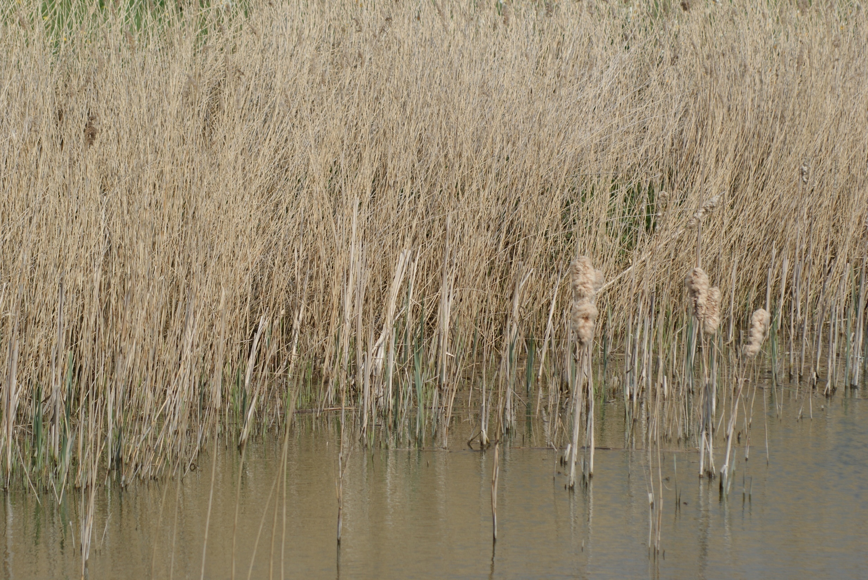
The rhizome: An alternative story notion
The rhizome: An alternative story notion
Sermijn, J., Devlieger, P., & Loots, G. (2008). The narrative construction of the self. Selfhood as a rhizomatic story. Qualitative inquiry, 14, 4, 632-650.

Slide 14
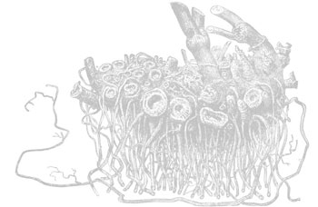
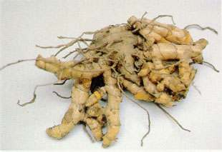
The rhizome: An alternative story notion
What is a rhizome? An underground root system, an open decentralized network, which branches out to all sides, unpredictably and horizontally.

Slide 15
Rhizome: Characteristics (Deleuze & Guattari, 1976)
The principle of multiple entryways (no main entryway or starting point: ‘from whichever side one enters, one is connected’)
The principle of multiplicity (no reduction to a whole or unity on subject or object level)
The principle of connection (no clear hierarchy, structure or order: each point can be connected with any other point)
The principle of asignifying rupture (at whatever point the rhizome is ruptured, it will always grow further)
The principle of cartography (just like a map the rhizome is open, receptive for constantly including changes)

Slide 16
The narrative self as a rhizomatic story: Multiple entryways
Not a single correct point of entry: not a single true self
Many possible entryways: many constructions of selfhood
As researcher you access only one or a few possible entries into the rhizomatic story of the participant
As researcher you become part of the rhizome (no ‘objective’ outside observer!): ‘as soon as you’re in, you’re connected’. Two rhizomatic networks which interact with each other and create common paths within the specific research context.
‘where should I start ...’ ‘I will just tell what I’m thinking right now, so last year …’
Ch: “No, I would never tell that part of myself that I now told you…I would never tell it to someone new, for me it’s part of the past. I told it because I know you’re interested in it for your research.”
The entry someone is using in his story network must be placed in the context within the telling takes place!

Slide 17
The narrative self as a rhizomatic story: Multiplicity
a multitude of stories: no reduction to one whole. There is not a single all-inclusive, coherent self story
Unity is an illusion as each telling is always local and temporary (a momentary, context-bounded self that speaks); it is a temporal take-over by one story.
The story that participant and researcher co-create offer no more than a fleeting glimpse of the multitude of possible stories that could be constructed.
A multitude of story elements, some coherent and linearly structured, others contradictory.
Now I’m completely better ... I don’t know if I’m really better ... I feel completely better ... It’s the past for me, that period ... There’s still some of those things in my head ...
How could we reduce such contradictory elements to a whole?
Thinking in terms of multiplicity implies that we pay attention to the richness of what Charlotte tells us.

Slide 18
The narrative self as a rhizomatic story: Connection
Stories are not always structured around logical, linear connections.
Traditional linear cause-effect thinking ➔ thinking in terms of infinite possible connections some of which become visible, many of them remaining invisible.
At the moment when Charlotte introduces her – often confusing and contradictory - feelings, she is not able to connect them with logical-linear principles.

Slide 19
The narrative self as a rhizomatic story: Asignifying rupture
The connections between the story elements can be shattered at any moment and replaced by new connections. A rupture is never fatal, as new connections always arise which create new paths.
The psychologist says it’s other stuff, that it has to do with my relationship with my parents … but I don’t believe that. I think that it comes from those books… What would my parents have to do with it? …
Two weeks later:
Last time I said that I thought I got anorexia because I started to read books about it when I was young. But in the meantime I have another idea about it … Those books were already the first symptom. Now I think that it has to do with my parents, the way they treat me. They want to control everything about me. And the anorexia, they couldn’t control that, it was my way to resist them …

Slide 20
The narrative self as a rhizomatic story: Cartography
We can compare narrative selfhood with a map of narrations that is always open and changing. An ongoing process of construction and reconstruction.
As a researcher you can never have a view on the complete map of one’s participant! You can only explore several regions and paths.
As I look back on my conversations with Charlotte and everything she told me about herself, I could conclude by saying that she and I made a trip together like two adventurers: we visited certain parts of the world extensively; others we only caught a glimpse of and still others remain unknown for us. After our trip the map doesn’t die, it just continues to grow further ...
(Sermijn, 2008)

Slide 21
The rhizomatic story perspective
Those 5 principles of the rhizomatic story perspective meet narrative selfhood as a multi-voiced process of co-constructing a multitude of fragmented, temporal and context-bounded stories, pathways and new voices

Slide 22
The rhizomatic story perspective
The rhizomatic story perspective fits the cultural-centred approaches which consider narrative as:
Performance
Narrative-in-context
Part of discursive sense-making processes
Embedded within a socio-cultural discourse context

Slide 23
Two concepts
Rhizome Jasmina Sermijn (2008) IDNS-PE, VUB Brussels
Lines of flight Maria Tamboukou (2008-10) CNR, UEL London
Gilles Deleuze Felix Guattari

Slide 24
Two concepts
Rhizome Jasmina Sermijn (2008) IDNS-PE, VUB Brussels
Lines of flight Maria Tamboukou (2008-10) CNR, UEL London
Gilles Deleuze Felix Guattari

Slide 25
Lines of flight
Narrative as a representation
With a plot that imposes a meaning on the events by revealing at the end a structure integrating all events in a coherent way
Gwen John

Slide 26
Lines of flight
Representations
Closed
Product
Gwen John

Slide 27
Lines of flight
An event is not what occurs (an accident), it is rather inside what occurs, the purely expressed

Slide 28
Lines of flight
It opens up yet unrealized possibilities:
Communication to come
New things to happen
The yet to come,
Forces that make change

Slide 29
Lines of flight
Processes
New beginning
Opening up fields of forces of power relations and desires

Slide 30
Lines of flight
Narratives are planes for the emission of new meanings as lines of flight out of the text and context

Slide 31
Current research
Families confronted with poverty and bereavement: using creativity to connect
Karen Puttemans
Dynamics of change in families dealing with severe parenting problems: IFPS in Flanders
Bert Van Puyenbroeck

Slide 32
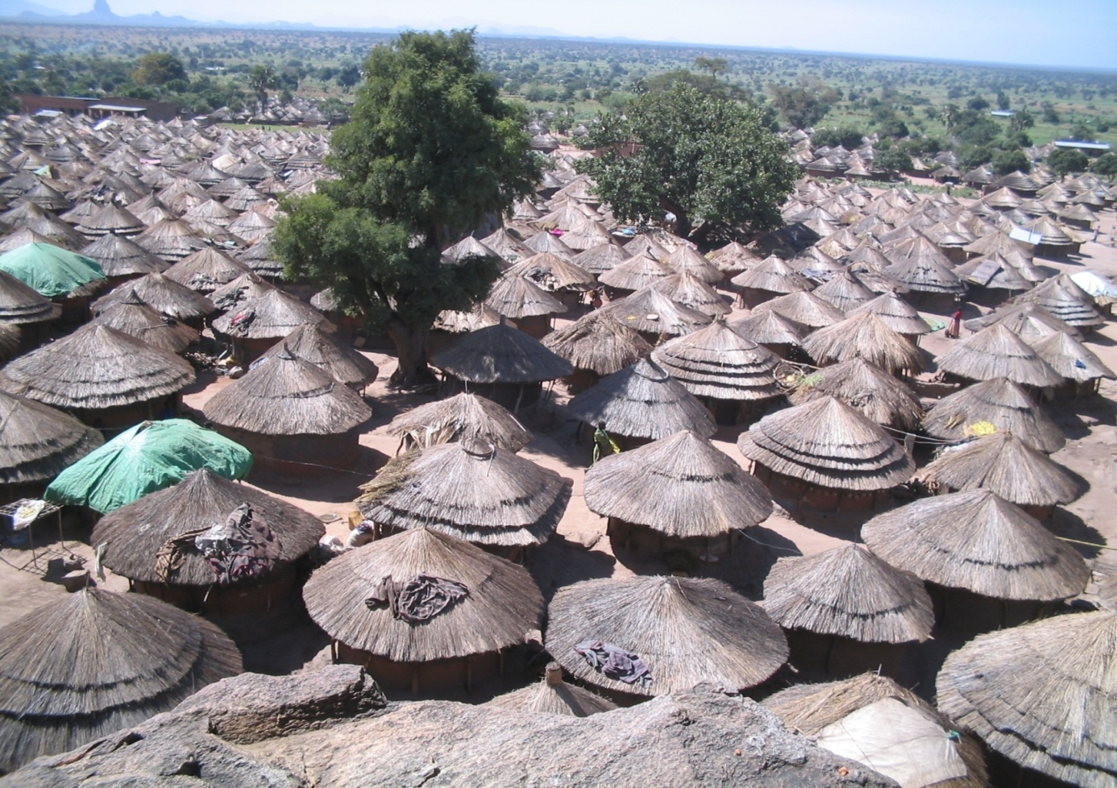
Resettlement of war-affected communities in Northern Uganda and a longitudinal follow-up of the reintegration process of former child soldiers
Kathleen Coppens

Slide 33
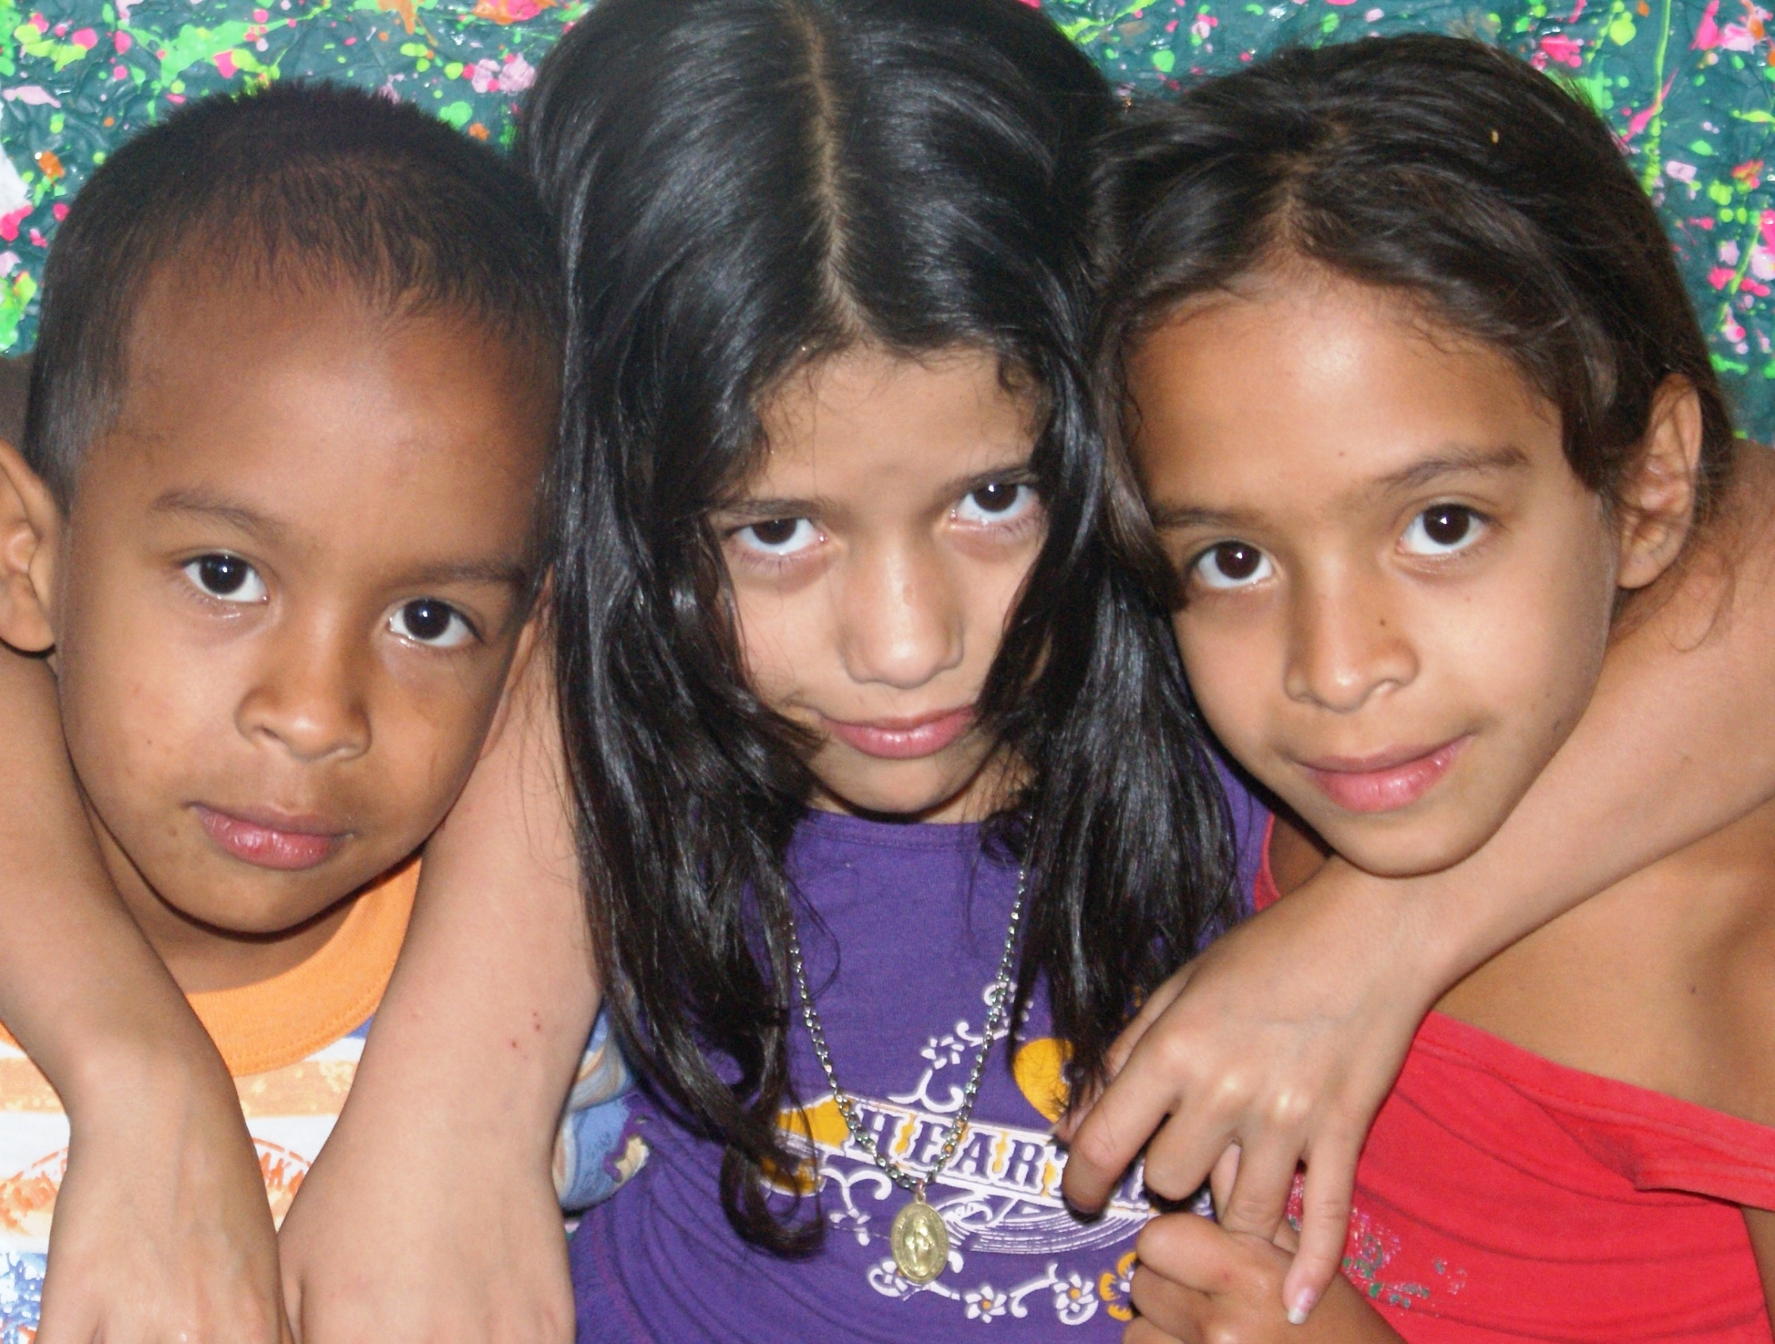
Living among armed groups and the construction of the self in Colombia
Julia Villanueva

Slide 34
Leaving the streets: Participatory action research with street children and their families. Improving family reunification programmes in poor urban communities in Bolivia
Isabel Berckmans

