Slide 1
Resilience & Narrative
A Narrative Analysis of
Natascha Kampusch’s Survival
Prof. Joachim Duyndam

Slide 2
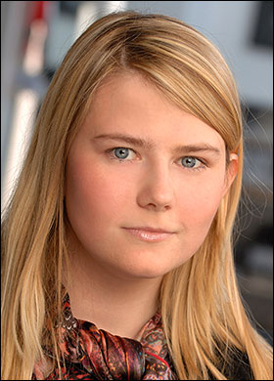

Slide 3
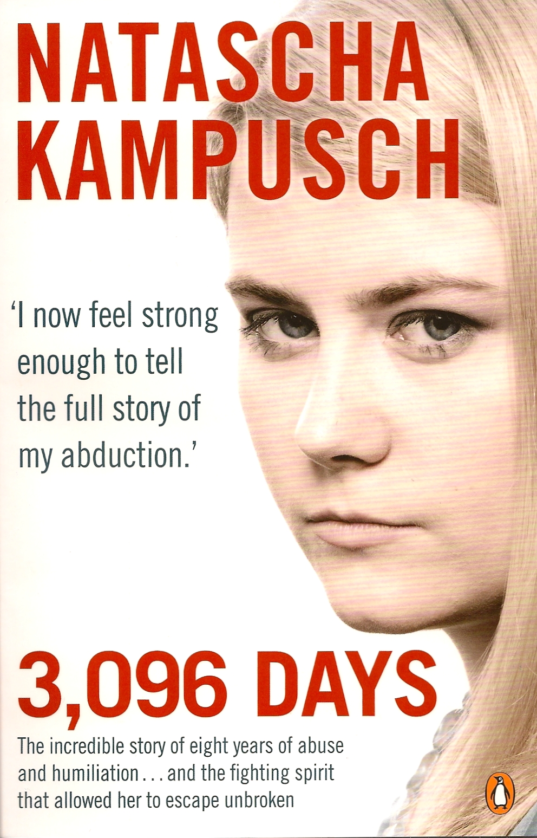

Slide 4


Slide 5
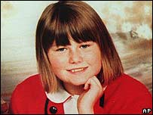

Slide 6
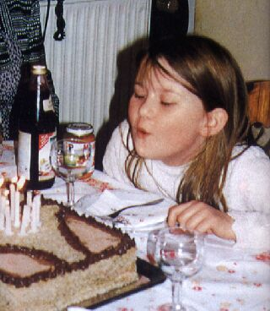

Slide 7
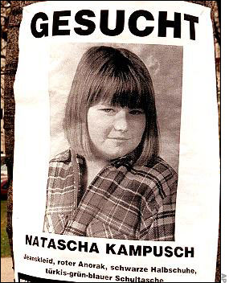

Slide 8
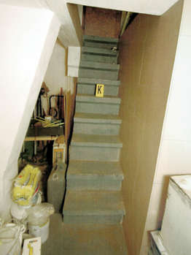

Slide 9
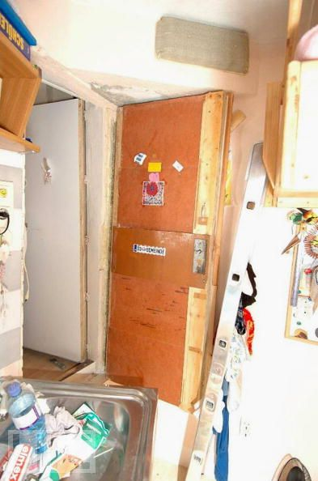

Slide 10
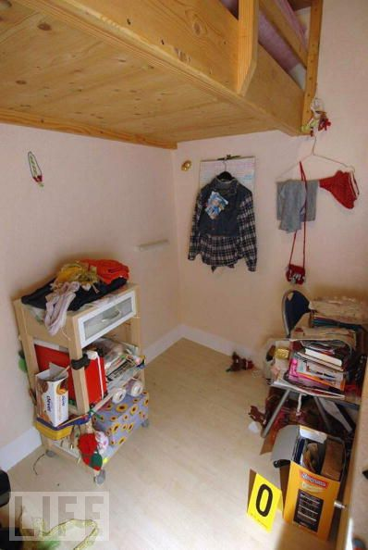

Slide 11
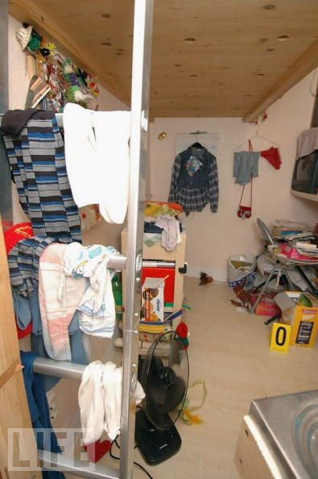

Slide 12
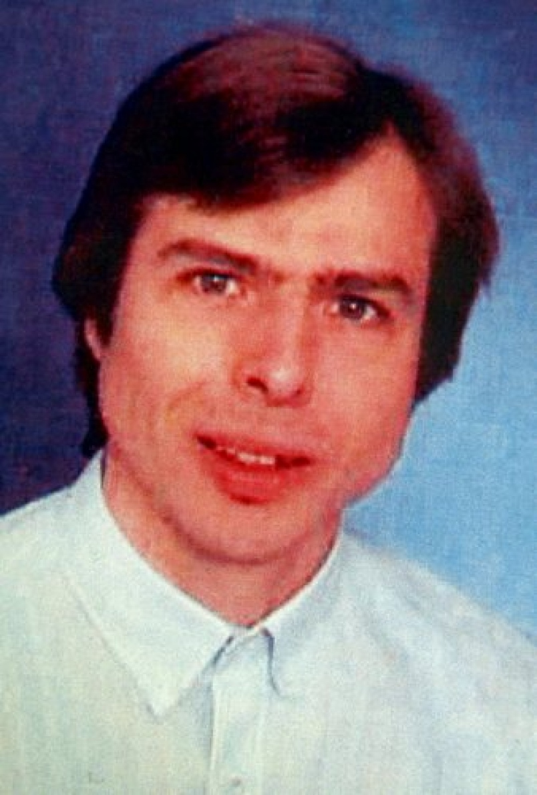

Slide 13
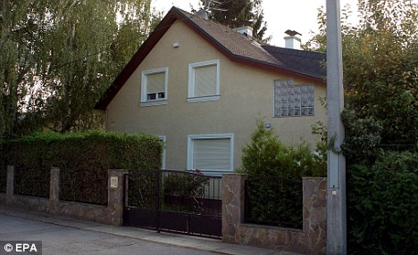

Slide 14
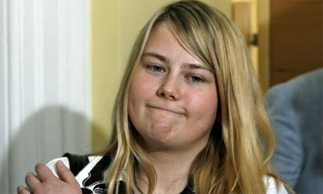

Slide 15
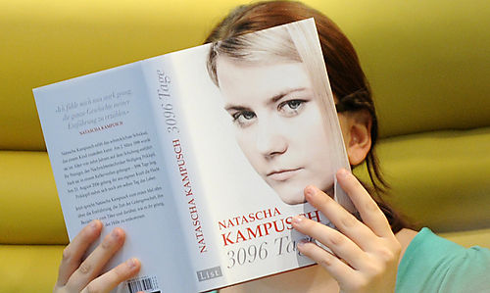

Slide 16
Resilience & Narrative
Survival through resilience

Slide 17
Narrative aspects of Natascha’s resilience
The story of her life is broken down / interrupted
Most importantly: Her relationships with her parents and other family, school, friends have been disrupted.
Her relationality has come under pressure; only one relationship left.
Her identity is taken off: from daughter, sister, schoolgirl, friend, she has become someone’s slave

Slide 18
Natascha’s response to her circumstances
Continuing her life story with the perpetrator, as a substitute family
Building up a relationship with him
She keeps seeing him as human – vs. – absolute evil
Looking for traits of goodness in this bad and sad(!) guy
The meaning of eating together (in the context of undernourishment/starvation)

Slide 19
“Storying has saved me”
Writing: a diary
Reading (e.g. Alice in Wonderland)
Rituals
The continuation of her life story is created under pressure
The stories she creates imagine the/her future
Potentiality – actuality

Slide 20
“Storying has saved me”
Most importantly: Creating an 18 year old self (o.a. p. 143)
She chats with her alter ego
She writes down the heartening statements of het alter ego (p. 194)
Her alter ego promises her to help her and to liberate her
Which is a typical narrative version of hope and determination

Slide 21
Balancing the power
Adaptation to the perpetrator and resistance (refusing)
He tries to mould her into his pure world of fantasy and paranoia
Refusal: calling him ‘maestro’ and kneeling down for him
However, the theft of her identity provides new possibilities (p. 122)
Still: oppression: torment and hunger
Withdraw and hit back (elasticity, like springs)

Slide 22
Escape
End good, all good?
Incongruity of narratives
The media: stories on and about Natascha Kampusch

Slide 23
Reflections on Narrativity
(closing remarks)

