Slide 1

Some thoughts on ‘convivial encounters’, presented by prof. Christine Bigby
Conference on Social inclusion of people with profound and/or multiple disabilities
@ University for humanistic studies, Utrecht (NL)
Beyond ‘binary thinking’: celebrate diversity
Alice Schippers, Phd, the Netherlands
May, 17, 2019
Notes:
Social inclusion OF, not by….

Slide 2
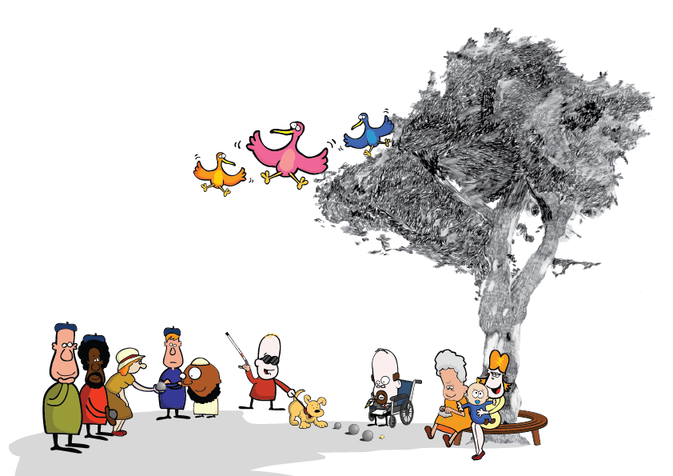
1. Beyond ‘binary thinking’
NL: ‘Participation society’: criticized
“Participation in Bricks” (Van Gennep, 2012)
System world colonizes life world (Baur and Abma, 2011)
Built-in boundaries (Bredewold et al, 2016)
No ‘real’ participation = meaningful,
sense of belonging
Conceptual maze (Bigby et al, 2018)

Slide 3
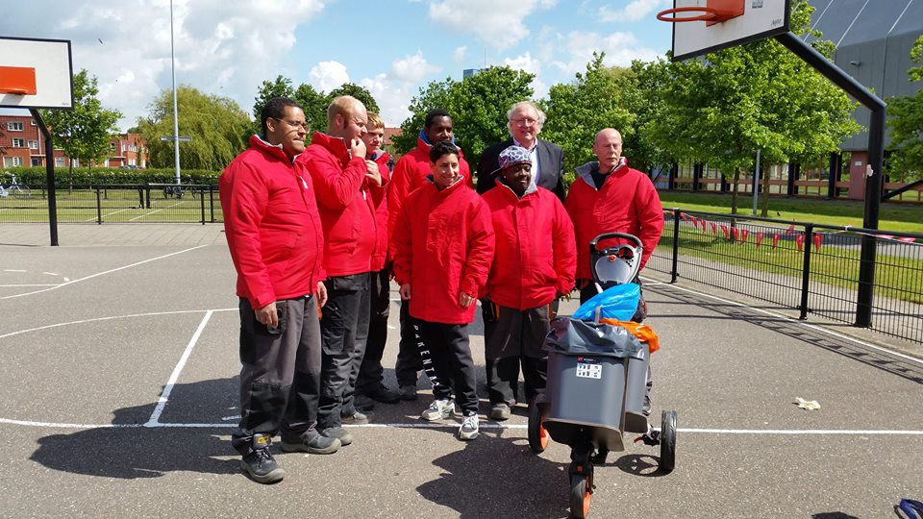
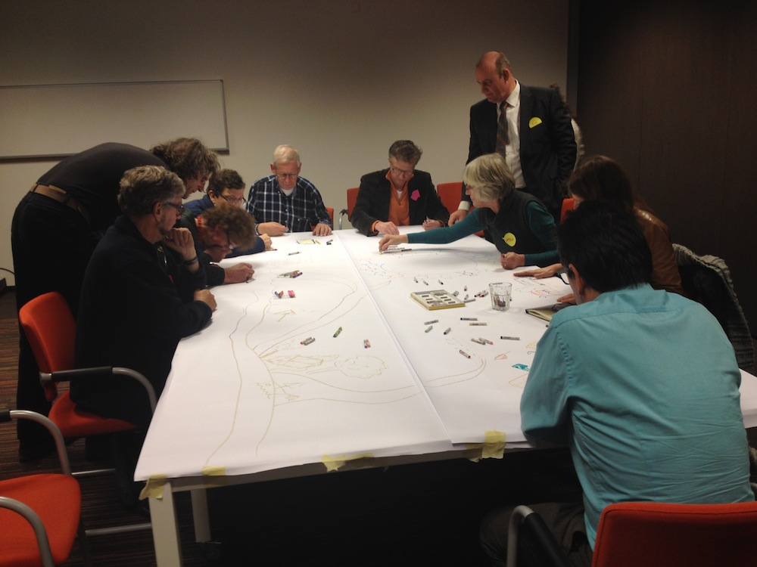
Finding new ways: nothing about us, without us
  ‘momentary shared identification’ ‘moments of everyday recognition’

Slide 4
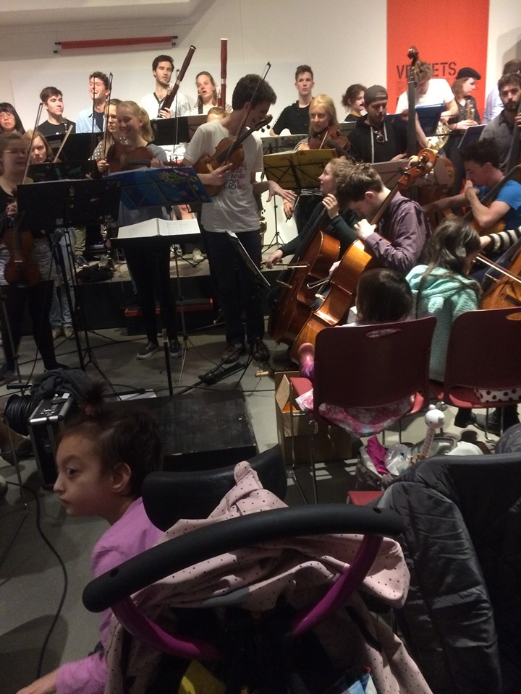
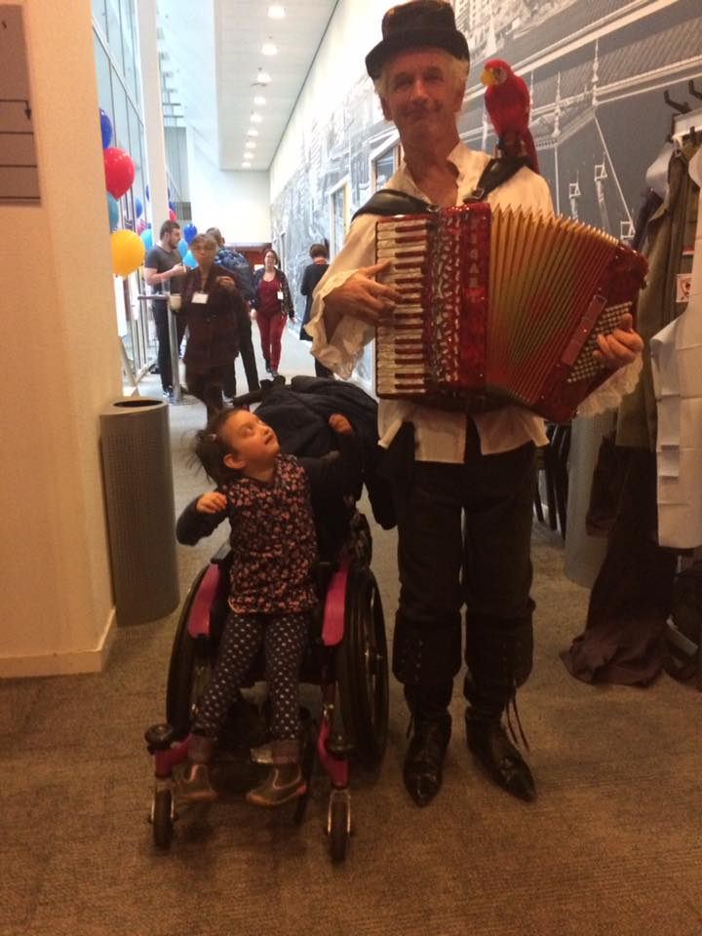
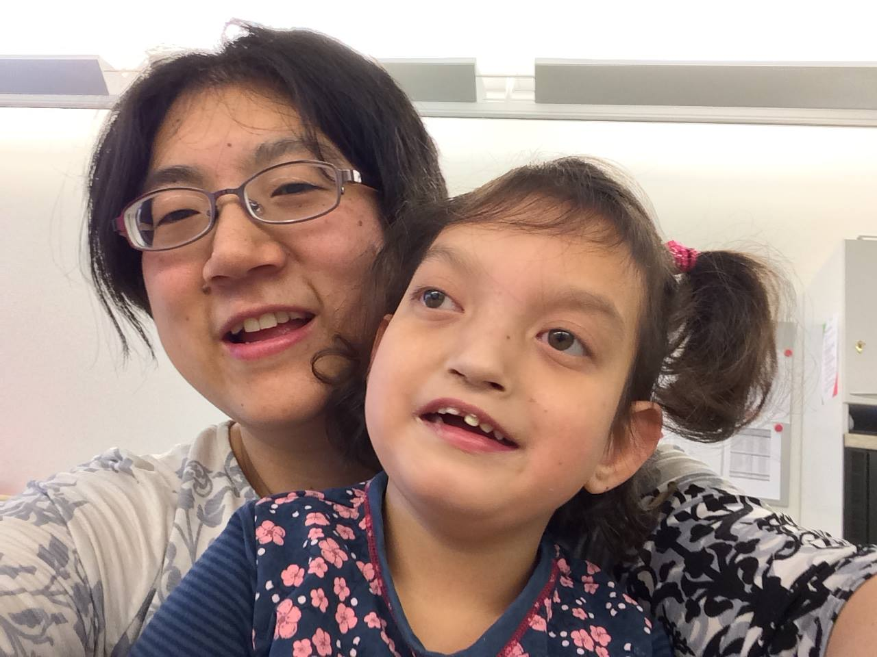
“The Art of Belonging”

Slide 5
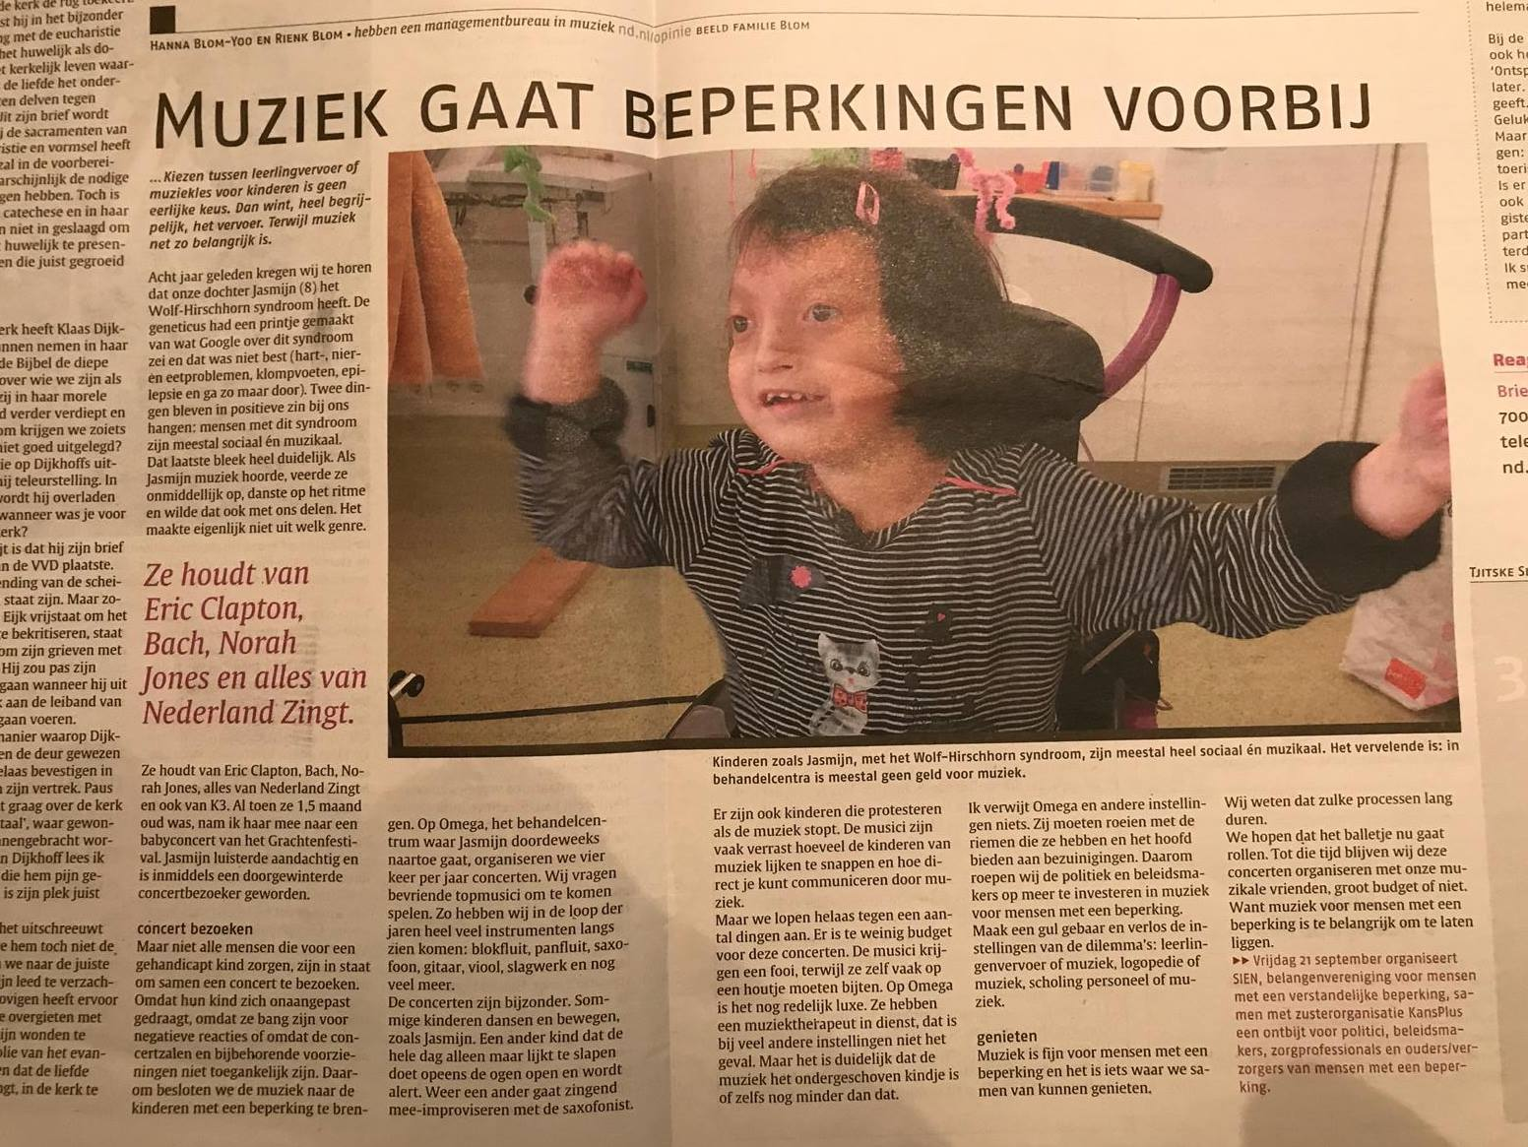
“The Art of Belonging”
Music to Belong

Slide 6
2. The importance of context
Social inclusion: whose responsibility?
‘Relatives -> importance of family
Public’ meaning -> normalcy, ableism

Slide 7
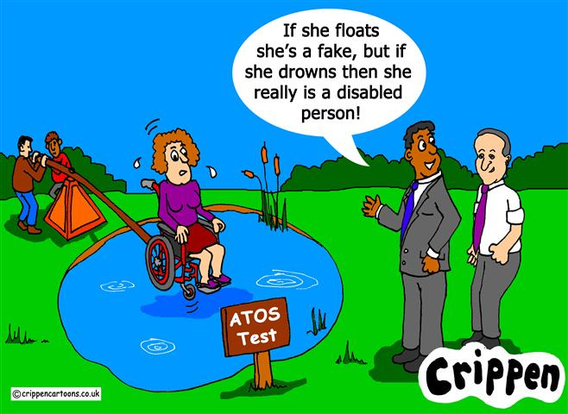
Who is in charge?
Social inclusion: shared responsibility?
Social roles: in/exclusion; role of (self) stigma; (implicit) values

Slide 8

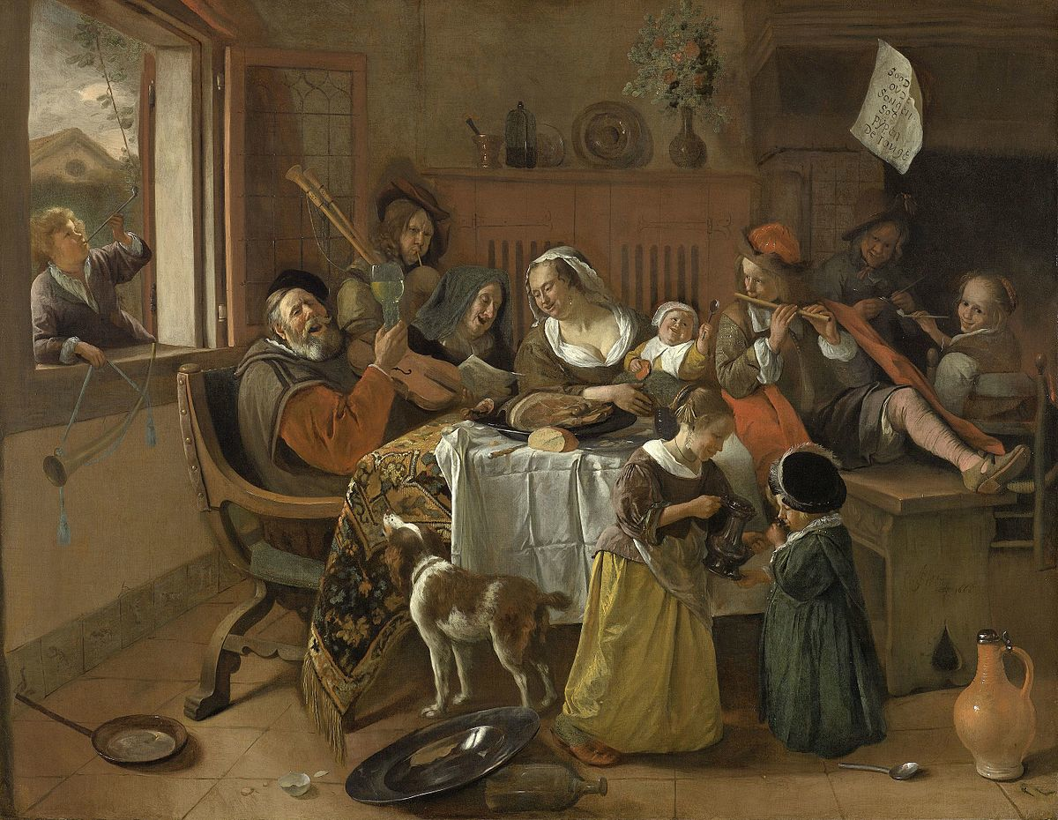
Families world wide are in charge
Community based = family based
Families worldwide are very similar
++ Quality of Life: Family relations, Values
-- Quality of Life: Informal and Formal support,
Community interaction
Worldwide less opportunities for
families
(From: Ongoing Int’l Family Quality of Life project)

Slide 9
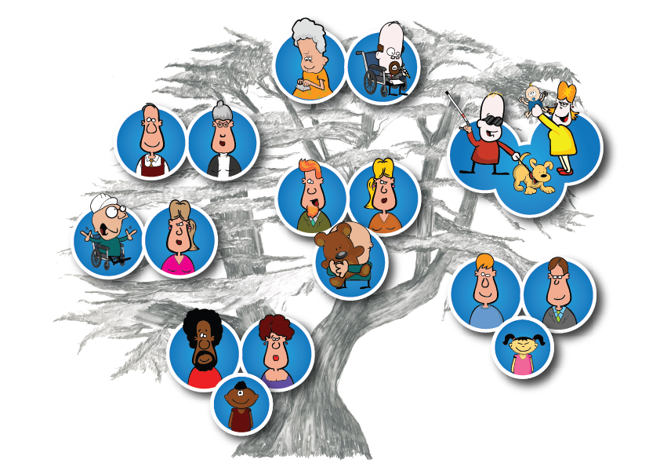
Families world wide are in charge
Community based = family based
Important topics:
Role of siblings
Strategies for the family as a whole
Inclusion of families in the community
Informal and formal support
  (Zuna, Brown & Brown, 2014)

Slide 10
‘Public’ meaning: normalcy
Social tyranny of normalcy: there is a ‘normal’ that tells you how to behave and how to judge (Davis, 1995, 2010)
Families feel confronted by norms, imposed on them, not being able to live a ‘normal’ life (Boelsma et al, 2018)

Slide 11
Beyond binary thinking: celebrate diversity
Society has a responsibility to provide for all;
-> instead of the ‘normal-abnormal’ dichotomy towards ‘equal aspects of human diversity”
(Brown et al, in press)

Slide 12
References
Baur, V. E., & Abma, T. A. (2011). Resident councils between lifeworld and system: Is there room for communicative action? Journal of Aging Studies, 25(4), 390–396. doi:10.1016/j.jaging.2011.03.001
Bigby, C., Anderson, S., Cameron, N. (2018). Identifying conceptualizations and theories of change embedded in interventions to facilitate community participation for people with intellectual disability: A scoping review. Journal of Applied Research in Intellectual Disabilities, 31(2), 165-80.
Boelsma, F., Schippers, A., Dane, M., & Abma, T. (2018). “Special” families and their “normal” daily lives: Family quality of life and the social environment. International Journal of Child, Youth and Family Studies, 9(4), 107-124.
Bredewold, F., Tonkens, E., & Trappenburg, M. (2016). Urban encounters limited: The importance of built-in boundaries in contacts between people with intellectual or psychiatric disabilities and their neighbors. Urban Studies, 53(6), 3371-3387.
Brown, I., Brown, R.I. & Schippers, A. (in press). A quality of life perspective on the new eugenics. Journal of Policy and Practice in Intellectual Disabilities.
Davis, L. J. (1995). Enforcing normalcy: Disability, deafness and the body. New York: Verso.
Davis, L. J. (2010). Constructing normalcy. In L. J. Davis (Ed.), The disability studies reader (3rd ed., pp. 3- 19). New York: Taylor & Francis.
Gennep, A. van (2012). Burgerschapsparadigma: een perspectief. Nederlands Tijdschrift voor de Zorg aan mensen met verstandelijke beperkingen. 38(1), 16-22.
Zuna, N. I., Brown, I., & Brown, R. I. (2014). Family quality of life in intellectual and developmental disabilities: A support-based framework. International Public Health Journal, 6(2), 161–184.

