Slide 1


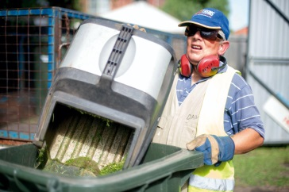
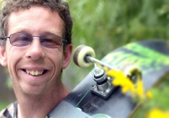
Using convivial encounter to create social inclusion for people with more severe intellectual disabilities: What does practice look like?
Professor Christine Bigby

Slide 2
Outline
Why focus on people with more severe and profound intellectual disabilities
Concept of encounter – what is it
Types of encounters – observed rather than deliberately created
What seemed to facilitate
Creating convivial encounters
Roles for support workers, identifying, negotiating/dealing with dilemmas
Macro and micro practice skills

Slide 3
Policy aims and failures
To support people with disability to live “as valued and participating members of the community” (1986 Disability Services Act)
Little success people with intellectual disabilities - more likely to be present than participating
But even less success for people with more severe and profound intellectual disabilities - ‘Pretty hard with our ones’
Paid workers support the idea of community participation they do not see it as feasible to apply to people with severe or profound intellectual disability (Bigby et al., 2009)
      ‘Lets be realistic’ – ‘it wont make any different’ ‘people are too different’
      Dominant culture in some services of ‘looking after people’ - other things if there is time.
Continue to live in a ‘distinct social space’
New innovative programs leave this group out

Slide 4
Blunt binary of social presence v social participation
  Use of facilities or services in the community available to everyone
  Being part of a growing network of relationships between people with and without intellectual disabilities (O’Brien, 1987).
  Ignores the spaces into between:
    value and diversity of social interactions in public, commercial or community places that are not firm relationships
  Potential of concept of Encounter used by urban geographers to
    understand diversity and social heterogeneity of modern cities
    where most people are strangers
    the shift from place based understanding of community

Slide 5
Defining Encounter between strangers
      “where people effectively agree to sustain for a time a single focus of cognitive and visual attention” (Goffman, 1961, 298)
      Attention to each others presence
      Social differences are negotiated, suppressed, transcended or amplified
      May support social cohesion “part of being included in a web of public respect and trust”(Jacobs, 1962, p. 56)
      But may also be negative or exclusionary

Slide 6
Convivial Encounters - people with intellectual disability
      Fill the void between passive presence and fully-fledged relationships and to inform practice with people with intellectual disabilities (Bigby & Wiesel, 2011)
        “more than free mingling in large public squares and spaces …encounters with a certain intent or purpose ...may be fragile and often fleeting...where urban inhabitants can explore shared identifications through shared activities...makes a nonsense of closed, fixed or reified identity” (Fincher & Iveson, 2008, p. 155)
      Social differences are secondary to momentary shared identification
      Require “…some sort of material base - cannot be coerced but can be encouraged by the right rules, the right props and the right places and spaces” (Peattie, 1998, p. 248)
Distinguished by place
    [ideally]Public non segregated or community organisations where there are others without disability
Diverse combination of place, interaction and activities with experiential element of pleasantness
Important in own right – And may lead to friendships

Slide 7
Typology of encounters – experienced by people with intellectual disabilities
Synthesis of findings (Bigby & Wiesel, 2011, 2015; Wiesel & Bigby, 2014, 2016; Wiesel, Bigby & Carling-Jenkins, 2013; Bigby & Wiesel 2019 )
  Convivial encounters: momentary shared identification
    Shared identity created by activity
      being part of a ‘clean up’ event a local park, where a participant shared an identity as a volunteer when he interacted in a light hearted manner on various occasions with other volunteers about the challenges of the task.
  Convivial encounters: moments of everyday recognition
    acknowledge not only presence but right to use a public space in a way that might be different from others
      service transactions – patience willingness to depart from standard procedures
      I tend to smile and acknowledge, even attempt a simple conversation. Some people stare, others ignore or feel uncomfortable. I do too feel uncomfortable…overcome it and attempt to talk and treat them the same as others that aren't disabled.
Notes:
Dance eg
…ten other couples, most of them elderly, and apart from Jack and Jenny … the instructor explains the moves of a certain tango dance, and all the couples follow. Every now and then she corrects a couple when they get a step wrong…Slight missteps are accepted with a general laughter from all the couples, including Jack and Jenny. The instructor acknowledges Jack and Jenny, speaks to them occasionally (once reminding Jenny to tie her shoe laces – but Jenny ignores this advice), but is somewhat less pedantic with them than with some of the other dancers.

Slide 8
Convivial encounters: repeated and becoming known
Transforming from strangers to acquaintances – welcomed by name regular users of café, bowling alley, sports club, church.
    At 9am, they [a group of people with intellectual disability] were able to enter the Bowling Alley. The manager knew everyone by name, and while taking the money asked, “how was work this week?”, “is that a new shirt?”, etc. She appeared to have a good rapport with everyone.
  Exclusionary encounters
    ‘The lady was window shopping. I have noticed impatience, frustration, snide remarks and looks of disgust. It really gets me down to see these responses’.
  Encounters within a ‘distinct social space’
  Non-encounters
Notes:
As the bus went along, more people got on the bus. Francis took up two seats by sitting on the outside of a seat of two, and having his arm across the second seat. As more people boarded the bus, he did get several rude looks, especially from older ladies who boarded the bus. There were no verbal comments. On each bus, Ian sits near the front on the disabled seating. He ignored people who needed these seats. Other people vacated their seats, including women with shopping bags, but Francis remained oblivious to their needs.
They do have them [people with intellectual disabilities], coming down there,
to learn and play bowls. . .But not on a Friday, no. . .I won’t say it’s a serious
day, but there’s a lot of competition, because [bowlers] come from other clubs
(local resident, Melbourne).
Disco for people with disabilities: Carla uses
the door which takes her first to the refreshments
area. She immediately finds someone
she knows and goes over to give them a hug.
No words are exchanged but the reception is
warm. The loud music inhibits good quality
conversation. Carla then sees a small man .
whom she obviously knows. She approaches
him and he smiles. He holds out his arms
for a hug and Carla hugs him . [Carla]
continues to look around as if trying to find
someone . Carla moves around slowly,
doing a ‘360’ as she continues to look out.
She does not appear happy, nor is she distressed.
For 20 minutes, she has no interaction
with anyone . She appears to be
scanning the tables, still looking for someone.
I am not sure if she is looking for someone
in particular or if she is just looking for
a familiar face.

Slide 9
What enables convivial encounters
Focus not the individual but the context/place, and actions of ‘public’ others and staff
These makes the difference between being there or attending and a convivial encounter or being actively involved
The Public
Some strangers more prepared than others
    People who are younger
    People with a relative with intellectual disability

Slide 10
What enables convivial encounters
    Places or groups with
    Lower socio economic profiles
    Country towns
    Shared common purpose or goal for being there
    Non competitive activity – low demand or expectations
    Opportunities for verbal and non verbal communication
    Built in boundaries, and clear rules and roles for social interaction (Bredwold et al., 2016).
    Presence of a dog
    Shared support for presence not just that of the leader
    Integrating activity bringing together participants at the start
    Equal status of all members not special
    Access and willingness to accept expertise to work through dilemmas of difference

Slide 11
What enables convivial encounters
Staff actions
Serendipitous - in the moment judgements
      supporting the person to manage the situation
    overcoming barriers such as moments of social awkwardness or concern about transgression of socially accepted norms
  May involve
    directly introducing a service user to a stranger
    inviting a stranger to join a conversation in explicit or subtle ways
    prompting person they support to initiate encounter on their own
    standing back and allowing the encounter to run its own course
    providing cues or acting as an ‘interpreter’ to assist a person or the stranger
    judging about when or if intervention was necessary
Almost identical to Person Centred Active Support

Slide 12
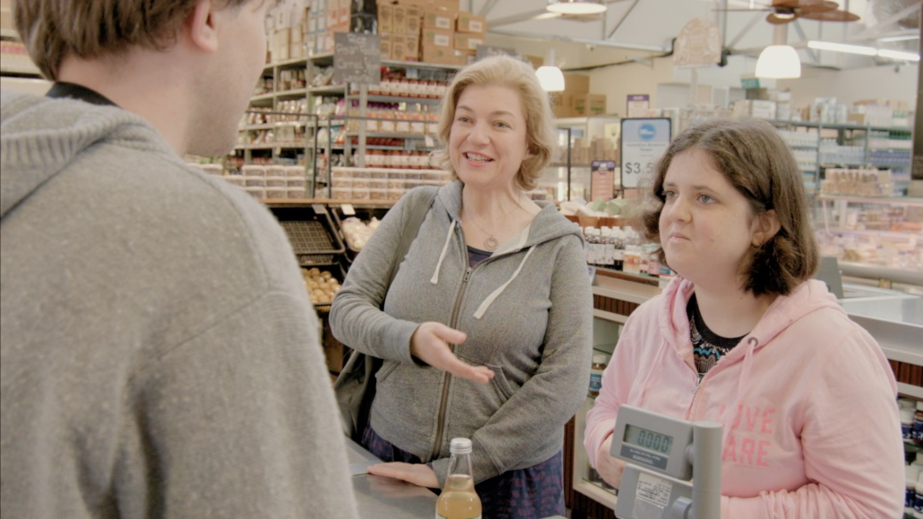
Staff - micro level practice
Seizing opportunities for encounter - 'every moment has potential'.
    without support there may be many 'missed opportunities‘
    community members - willing to interact by making eye-contact or smiling person with intellectual disability misses the signs or seems unsure how to respond.
Responding to opportunities Café Bank
    directing their attention to subtle signs
    prompting
    making an introduction
    making an interpretation
Letting go
    respect privacy – watch body language
  Making judgments
    Stepping back - Difficult behaviour

Slide 13
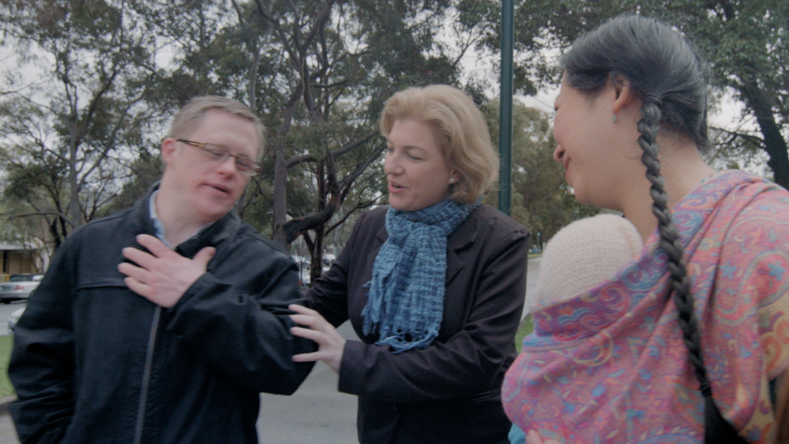
Staff may also obstruct or compromise encounters
  Groups - dynamics
  Busy schedules – take too much time
  Protect people or the public
  Speaking on behalf of people
  Poor planning
  Disrespect for existing relationships
  Yoga Hairdresser Getting in the way

Slide 14
More deliberating creating convivial encounters
Reformulating and reconceptualising day programs
Melba Community Connections Program
& Shepparton Access
Operated from number of sites
Segregated but close to mainstream
Typical day 2 hours on site 4 hours off site
Approx. 90 participants 3-5 days a week
Range of support needs - included people with very high needs
Part time and full time staff 20 –35 EFT
Primary strategy to create an individually tailored mix of activities that always include engagement in specific tasks and social interactions with community members, may have element of reciprocity or skill development – in collaboration with others in the locality

Slide 15
Example participant Chloe
Regular convivial encounters at the primary school - enjoys the children ‘saying hi’ to her
And at the pool where she often walks up and down the length of the pool holding hands with another person who is also a regular attender.
Chloe’s support workers say that she has made ‘lots of good friends’ at the pool and that she is always greeted warmly.
Delivering newspapers to the same businesses each week has created an opportunity for her to interact with the staff in those businesses.
Chloe is a 27-year-old woman. She has a severe intellectual disability, does not use words and has low vision.
Does voluntary work at a local primary school library re-shelving books
Is part of a small team which delivers newspapers
Has lunch or morning tea at a favourite local café
Works at a farm which grows produce used in Community Connections cooking activities
Goes swimming at the local pool regularly same time same day each time

Slide 16
Interconnected Strategies
Individual
interests, function, support needs
each person has their own program
Program
across individuals to create opportunities for more than one person at a time
e.g. creating a social enterprise or a class + utilise and coordinate staff
Context
Knowledge of the locality who and what is already there businesses, facilities, events
It's very, very personal, and it's flexible around that person. It needs to be what they need it to be, but then we need to develop the program around that…It’s very purposeful very planned but it looks to other people like it’s not. We don’t try to fit people in, we build things for them from the ground up.
(Prue, staff)
Planning

Slide 17
Creating opportunities for convivial encounters
Creating an activity in a mainstream place for an individual e.g. volunteering in a kindergarten, or supported work in a school.
Finding public facilities that offer activities open to all comers e.g. public sessions at a swimming pool.
Seeking out Established group activities in mainstream places to join either individually or as a small group e.g. yoga or art class in a community centre.
Creating group activities that use or visit mainstream places and involve collaboration with other groups in the community. For example, a cooking class in an older person’s home, a fruit collection and delivery service to local schools.
Inviting others into program spaces by creating social enterprises that produced and sold products or services to customers e.g. Able Bakehouse and Ecoshop.

Slide 18
Skilled practice of turning opportunities into convivial encounters
Reading features of places or groups – how do they match up to more welcoming places (integrating activity, open to expertise, support from members, equal membership, shared purpose etc)
Matching individual interests/characteristics to group culture
Negotiating entry and reservations for inclusion – fit – status quo
Working through processes of group adjustment with members (expectations, feedback)(op shop)
Offering expertise to support difference helping to acknowledge (kitchen)
Designing activities for engagement and social interaction (bake house)
Direct support to individual and passing on skills to enable engagement to natural supporters/mentors
Managing the temporal dimensions – regularlity, right time right place – informal and formal time (Soldatic et al., 2019)
Long term and or intermittent support to participate – take account of change
Notes:
Direct feedback – value – do and don’t - not behind back

Slide 19
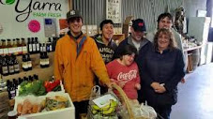
Attention to engagement and interaction as well as place
Focus on the detail of ensure engagement - not just volunteering in a place but volunteering to do specific things
Frequent use of task analysis
Second bite project - collecting fruit, preparing, delivery to schools, collecting containers and scraps to chicken farm
Planned so each participant has a role
Opportunity for encounters with others
Contribution to community

Slide 20

Staff Skills
Disability Support Practice
Micro skills
Community work
Active Support, Active Mentoring, Risk Enablement, Support for Decision Making, Task Analysis, Person Centred Planning, Positive Behaviour Support, Tailoring Communication
Mapping & Analysis
Networking &
Negotiation & Advocacy
Event Management
Team work

Slide 21

Reflections
  Outcomes of convivial encounters
    Enjoyment, sense of belonging, contribution, confidence and skill development
    Serendipitous convivial encounters outside program activities becoming recognised by others in locality
    Community members have increased contact with people with intellectual disabilities under conditions likely to contribute to changed attitudes - common interest, equal – personal interaction and cooperation , supported by authorities (contact theory)
    Social capital creation - social enterprises – reciprocity – and creation of groups
Beware of undervaluing of staff skills v values - potentially negative implications for recruitment, scaling up, costing
Skills span disability direct support practice and community development, need to map competences not assume the same as direct support for everyday living

Slide 22
Conclusions
Only the tip of the iceberg visible as moments of encounter - conversing with other members of a cooking class or serving a customer with biscuits.
Multi-faceted work of enabling community participation ‘behind the scenes work and value of a collective approach - ‘the program’
Demonstrated planning, thought and skill that programs bring together collective and concerned with the group of individuals at the same time individualised and tailored
Programs can provide ingredients of enabling that can be mixed and matched to an individual.

Slide 23
References
Bigby C., & Wiesel, I, (N.D.) Supporting Inclusion Online Training Resource, SupportingInclusion.weebly.com
Bigby, C., Anderson, S., Cameron, N. (2018). Full report: Designing effective support for community participation for people with intellectual disabilities. Report for Disability Research and Data Working Group. Melbourne La Trobe University, Living with Disability Research Centre. http://hdl.handle.net/1959.9/563536
Bigby, C., & Wiesel, I. (2011). Encounter as a dimension of social inclusion for people with intellectual disability: Beyond and between community presence and participation. Journal of Intellectual & Developmental Disability, 36(4), 259-263.
Bigby, C., & Wiesel, I. (2015). Mediating community participation: practice of support workers in initiating, facilitating or disrupting encounters between people with and without intellectual disability. Journal of Applied Research in Intellectual Disabilities, 28(4), 307-318 .
Bredewold, F., Tonkens, E., Trappenburg, M. (2016) Urban encounters limited: The importance of built-in boundaries in contacts between people with intellectual or psychiatric disabilities and their neighbours. Urban Studies, 53,16, 3371-3387
Bould et al., (2018) More people talk to you when you have a dog. Journal of Intellectual Disability Research https://doi.org/10.1111/jir.12538
Bigby, C. & Wiesel, I. (2018) Using the concept of Encounter to further the social inclusion of people with intellectual disabilities: What has been learned? Research and Practice in Intellectual and Developmental Disability https://doiorg.ez.library.latrobe.edu.au/10.1080/23297018.2018.1528174

Slide 24
Clifford-Simplican, S., & Leader, G. (2015). Counting inclusion with Chantal Mouffe: a radical democratic approach to intellectual disability research. Disability & Society, 30(5), 717-730
Craig, D., & Bigby, C. (2015). “She’s been involved in everything as far as I can see”: Supporting the active participation of people with intellectual disabilities in community groups. Journal of Intellectual and Developmental Disability. 40, 12-25 http://www.tandfonline.com/doi/full/10.3109/13668250.2014.977235
Goffman. E. (1971) Relations in Public. New York: Basic Books
O'Brien, J. (1987). A framework for accomplishment. Decatur, Georgia: Responsive Systems Associates.
Wiesel, I., & Bigby, C. (2014). Being recognised and becoming known: Encounters between people with and without intellectual disability in the public realm. Environment and Planning A, 46(7), 1754-1769.
Wiesel, I., & Bigby, C. (2016). Mainstream, inclusionary, and convivial places: locating encounters between people with and without intellectual disabilities. Geographical Review, 106(2), 201-214.
Wiesel, I., Bigby, C., & Carling-Jenkins, R. (2013). 'Do You Think I'm Stupid?': Urban Encounters between People with and without Intellectual Disability. Urban Studies, 50(12), 2391-2406.

Slide 25
Contact
C.Bigby@latrobe.edu.au

